Slide 1
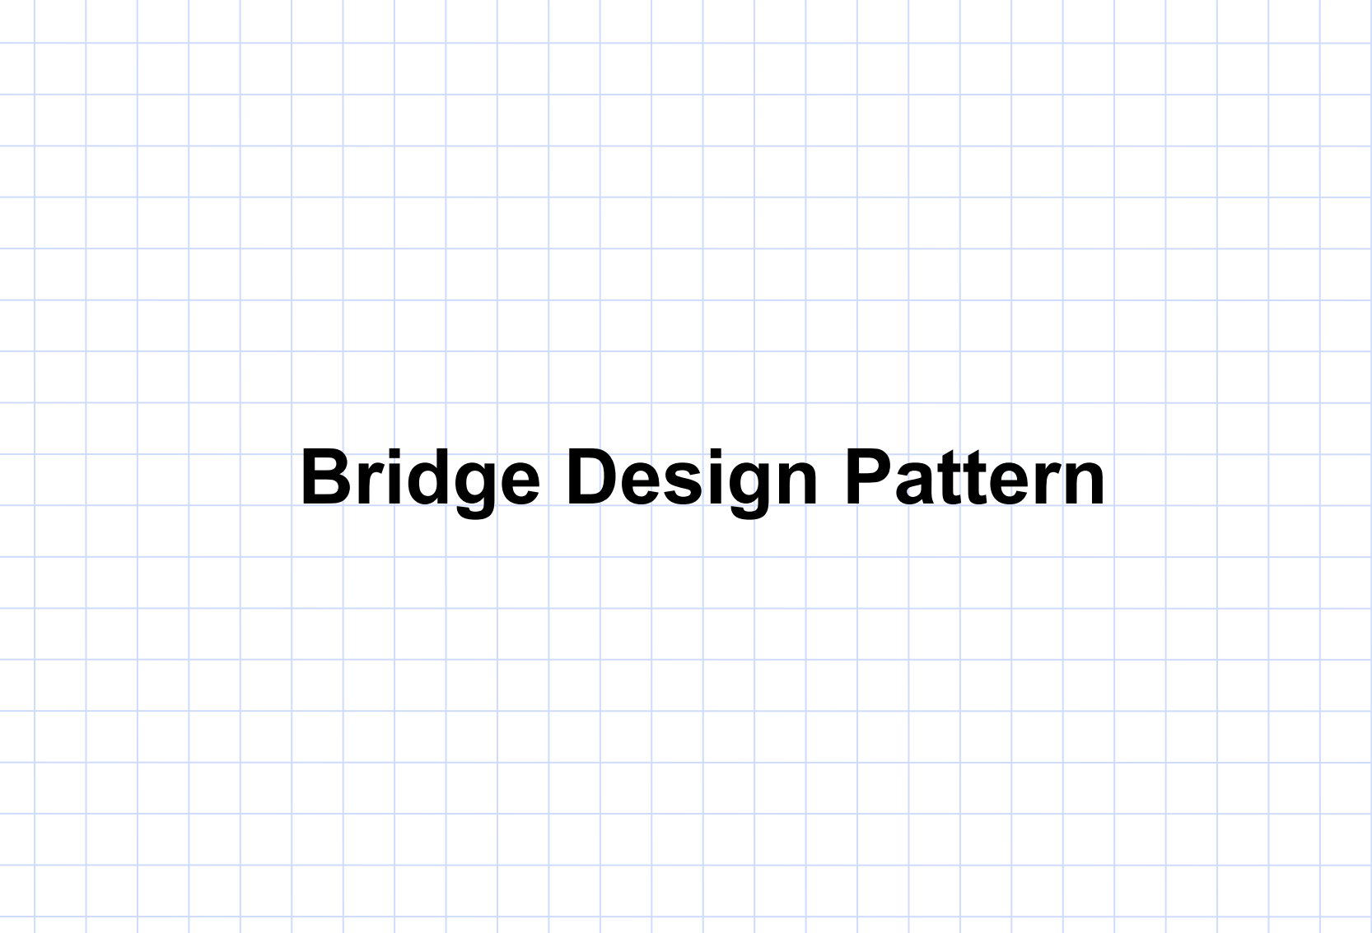

Slide 2

Alice

Slide 3
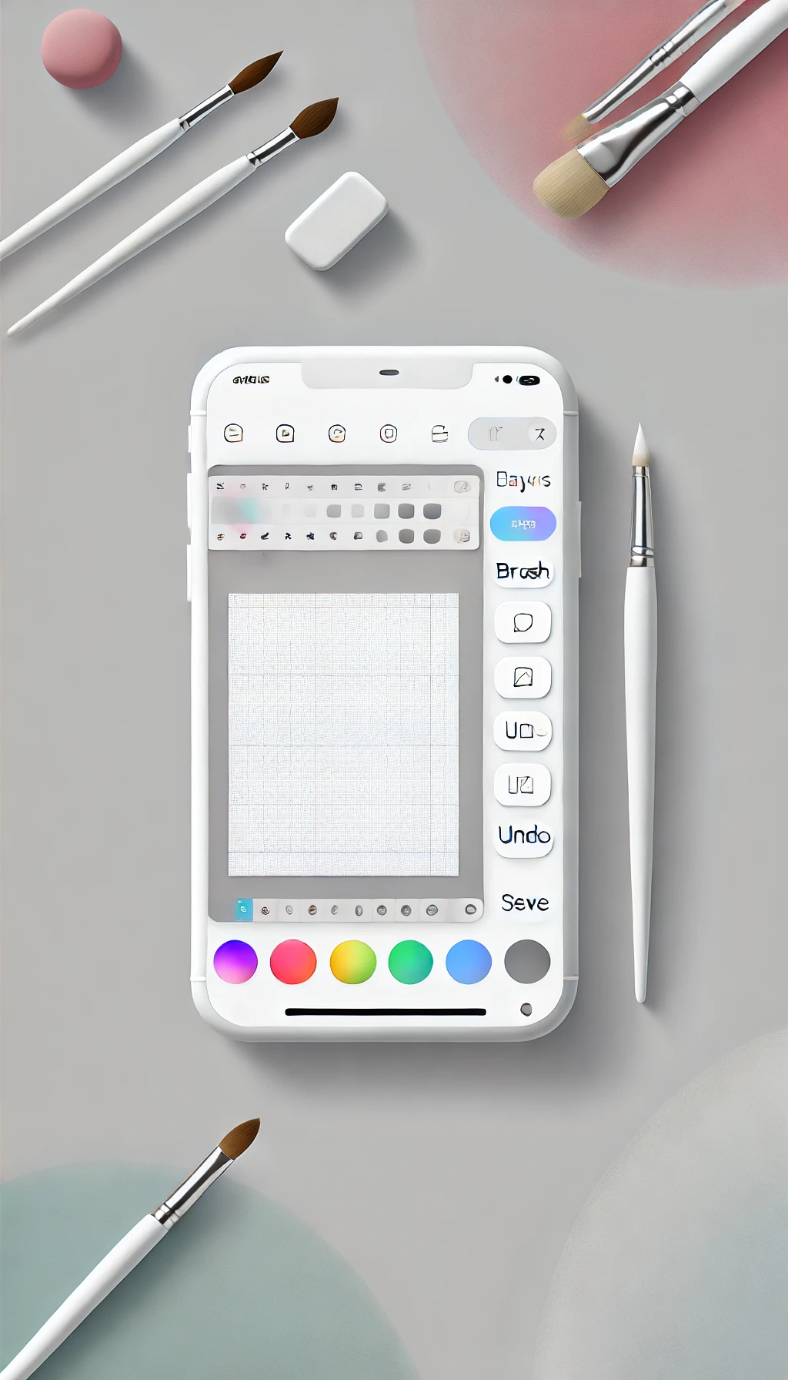
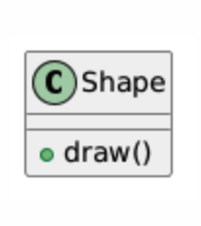

Alice
Drawing app

Slide 4
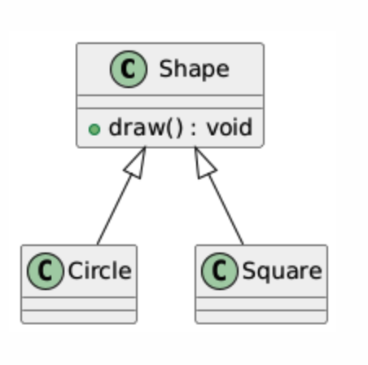
So boring
Drawing app

Slide 5

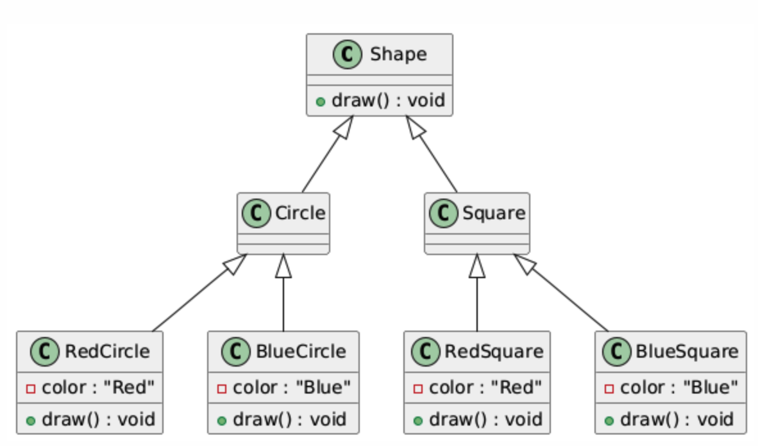
Too many classes
Drawing app

Slide 6

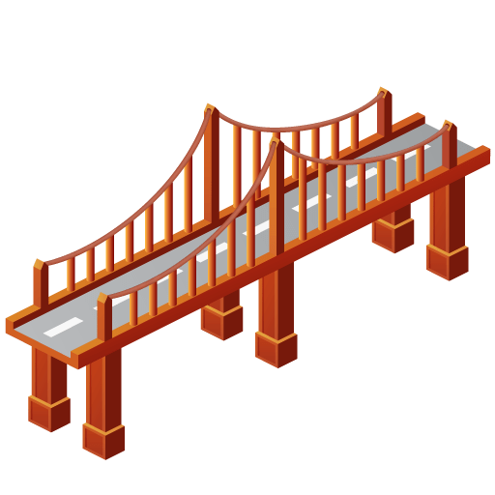
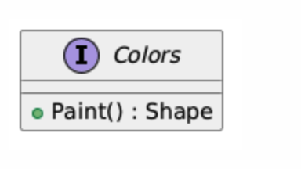
Bob

Slide 7
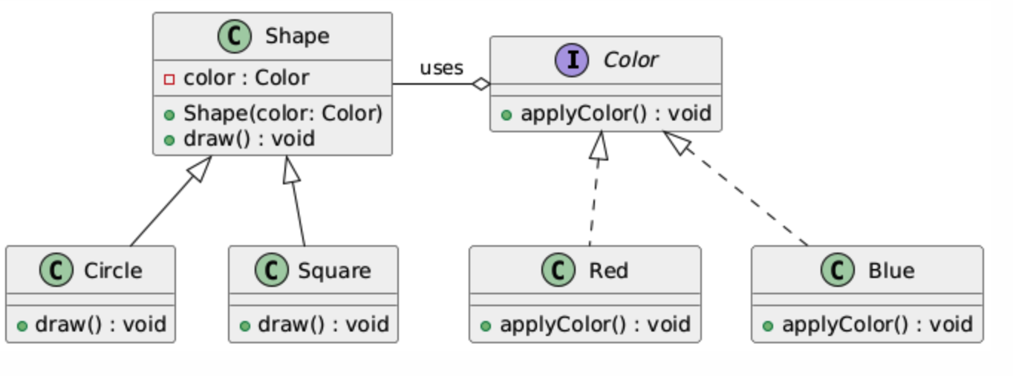
Bridge Design Pattern
Shapes will be the high-level Abstraction.
Colors will be the Implementor.
Abstraction
Implementor
Refined Abstraction
Concrete Implementor

Slide 8
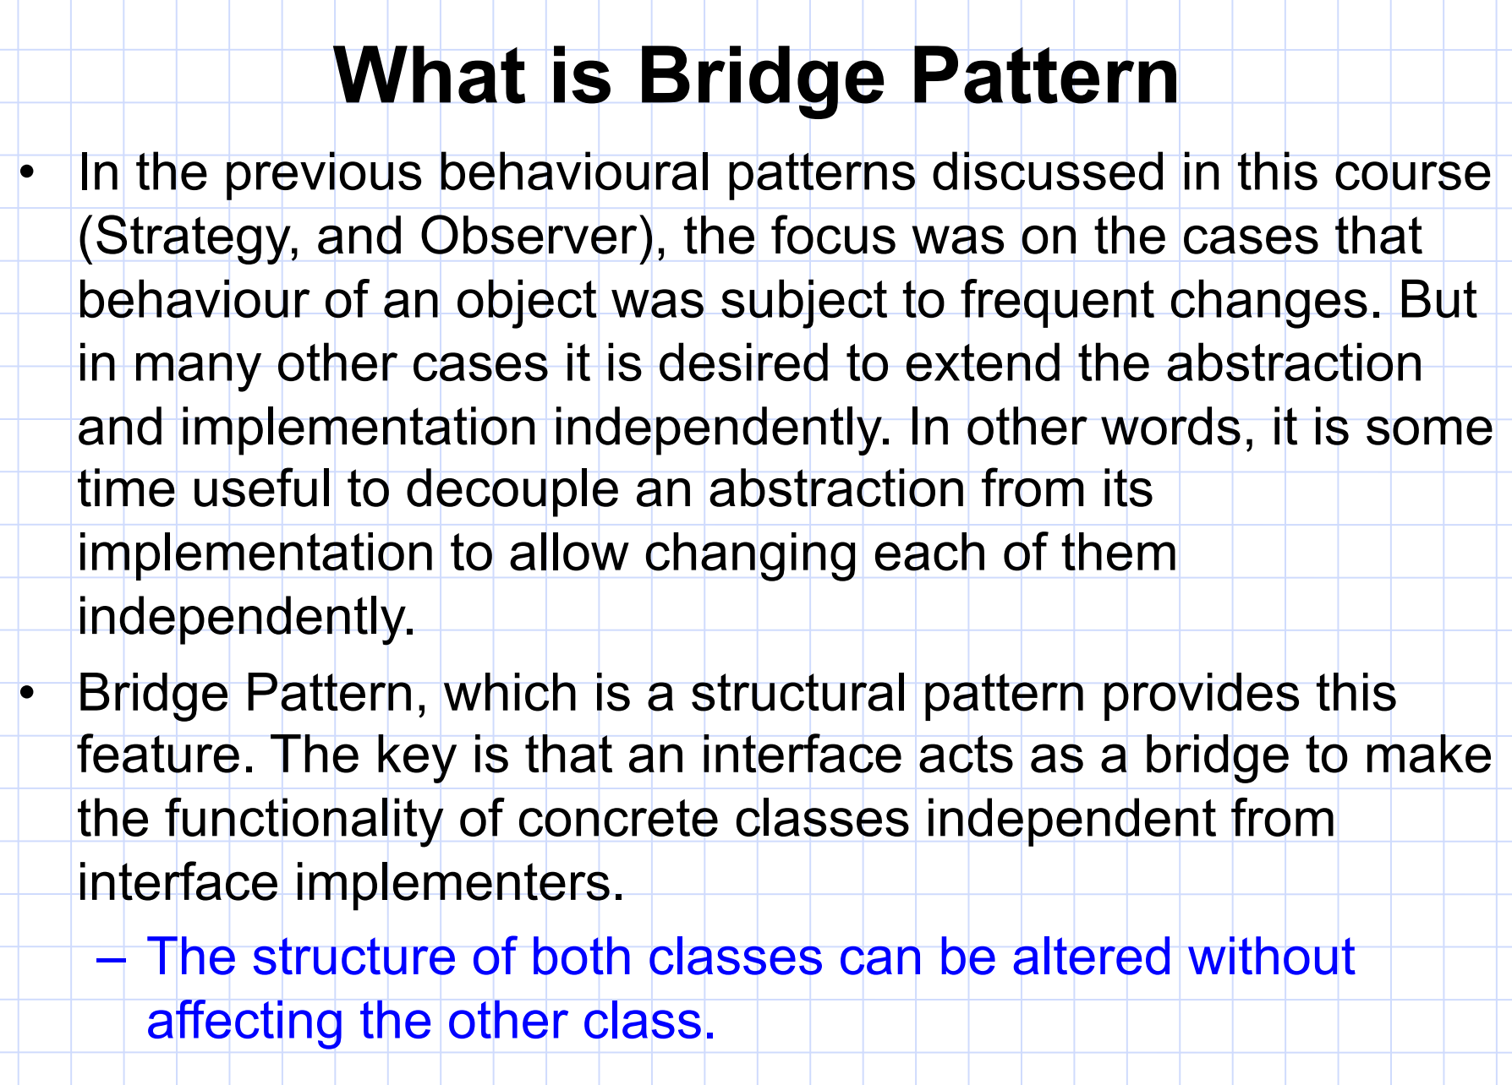

Slide 9
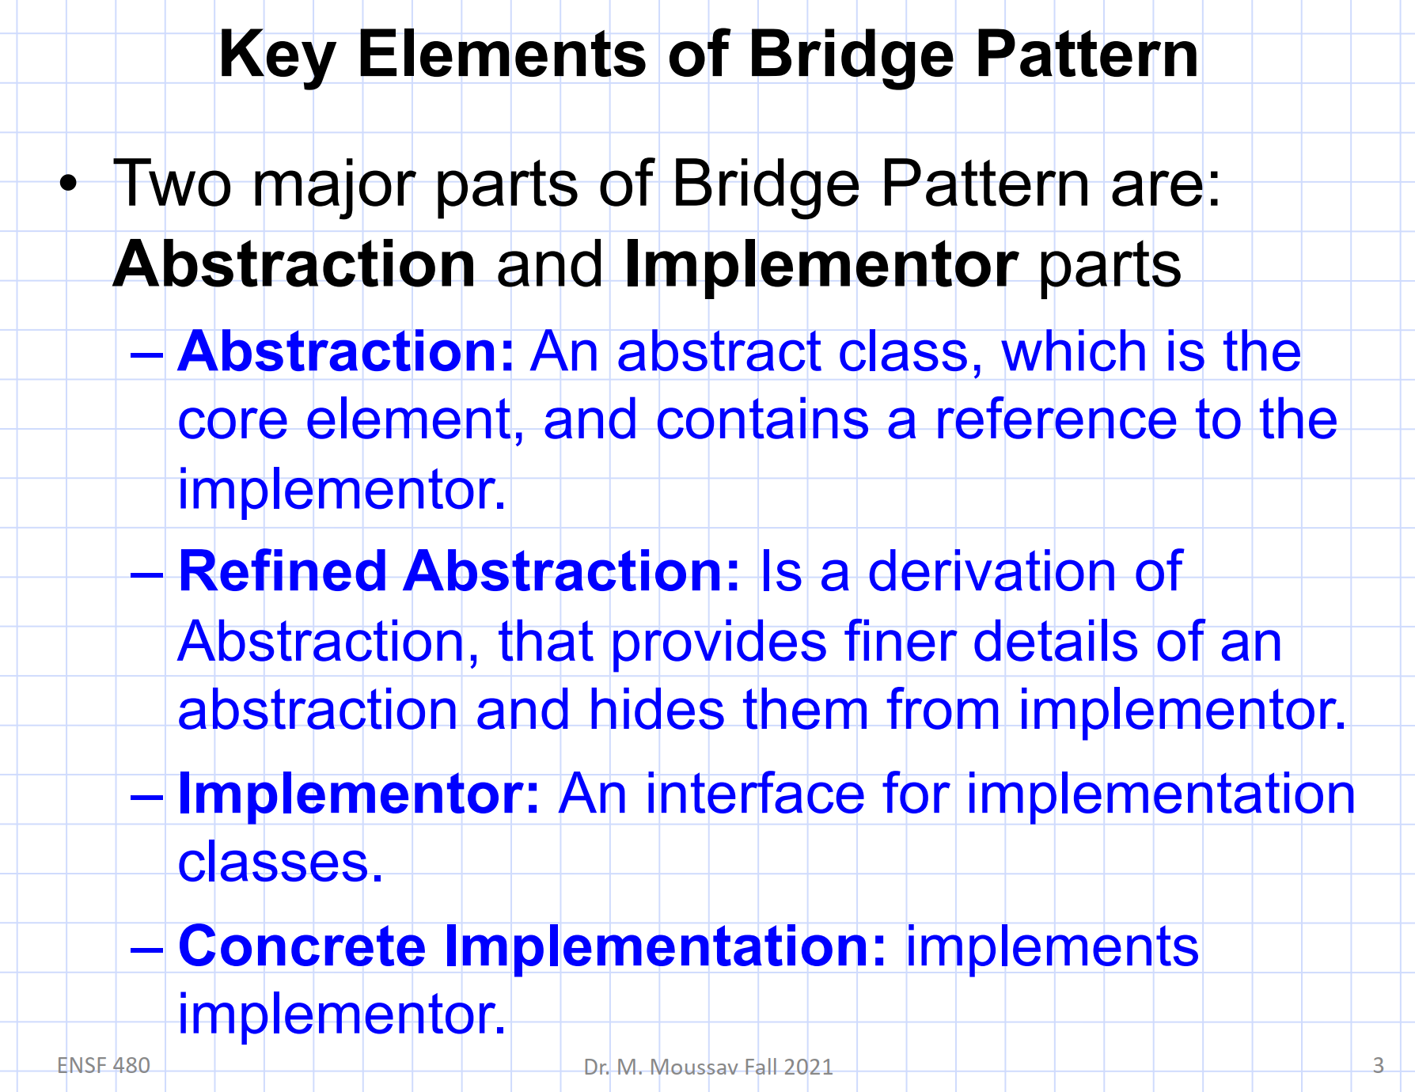

Slide 10
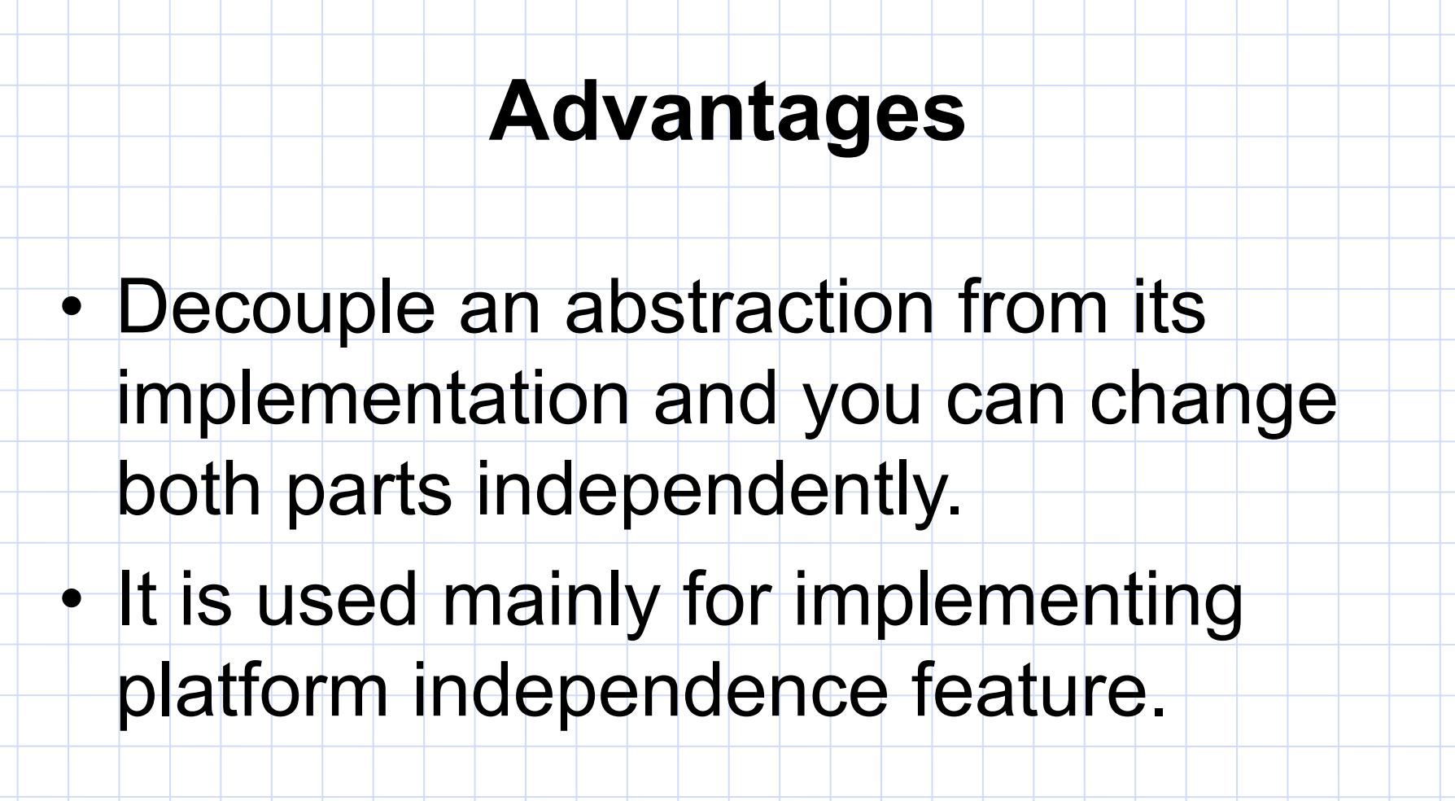

Slide 11
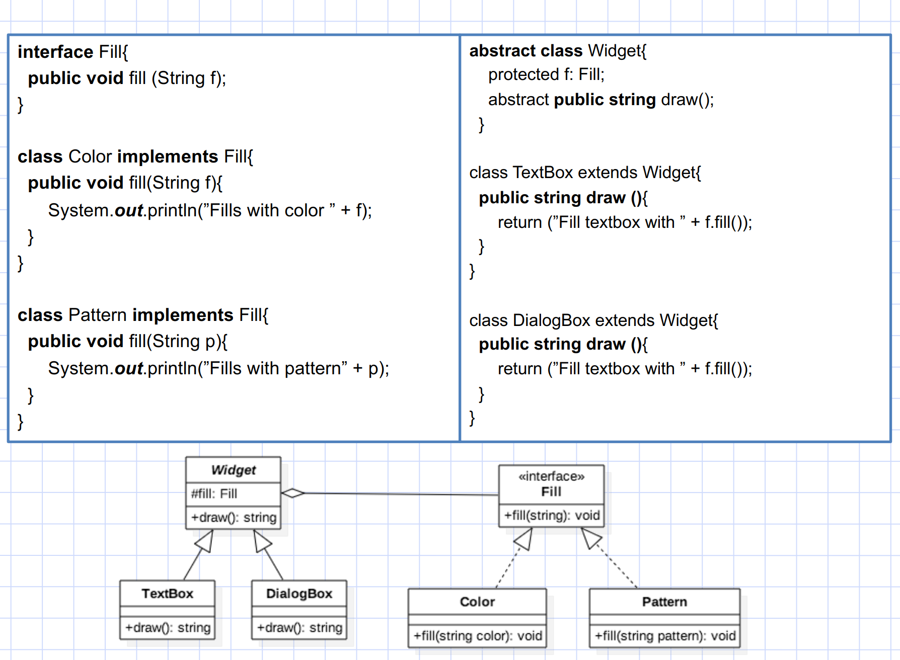

Slide 12
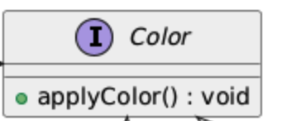
Bridge Design Pattern
// Implementor
interface Color {
void applyColor();
}

Slide 13
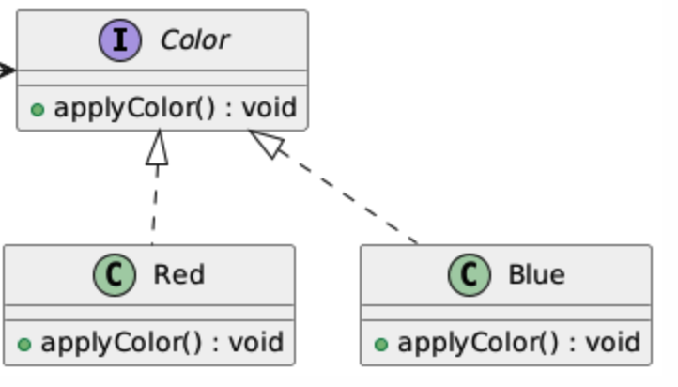
Bridge Design Pattern
// Concrete Implementor - Red
class Red implements Color {
@Override
public void applyColor() {
System.out.println("Applying Red color.");
}
}
// Concrete Implementor - Blue
class Blue implements Color {
@Override
public void applyColor() {
System.out.println("Applying Blue color.");
}
}

Slide 14
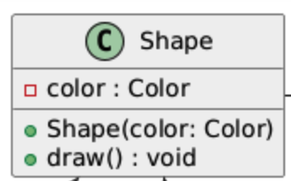
Bridge Design Pattern
// Abstraction
abstract class Shape {
protected Color color;
// Constructor to associate a color with a shape
protected Shape(Color color) {
this.color = color;
}
abstract void draw(); // Abstract method to be implemented by concrete shapes
}

Slide 15
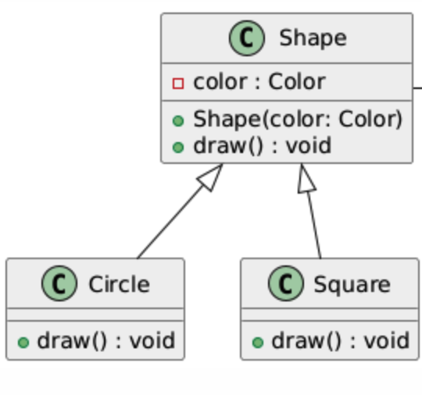
Bridge Design Pattern
// Refined Abstraction - Square
class Square extends Shape {
public Square(Color color) {
super(color);
}
@Override
void draw() {
System.out.print("Drawing Square - ");
color.applyColor();
}
}
// Refined Abstraction - Circle
class Circle extends Shape {
public Circle(Color color) {
super(color);
}
@Override
void draw() {
System.out.print("Drawing Circle - ");
color.applyColor();
}
}

Slide 16
Bridge Design Pattern
public class BridgePatternExample {
public static void main(String[] args) {
// Creating specific colors
Color red = new Red();
Color blue = new Blue();
// Creating specific shapes with colors
Shape redCircle = new Circle(red);
Shape blueSquare = new Square(blue);
// Drawing shapes
redCircle.draw(); // Output: Drawing Circle - Applying Red color.
blueSquare.draw(); // Output: Drawing Square - Applying Blue color.
}
}

